Slide 1

CAREPLUS HOSPITAL MANAGEMENT SYSTEM BUSINESS ANALYTICS PROJECT

Slide 2
ABOUT TEAM MEMBERS:-
K.VENKAT RAJ ACHARI
B.TECH IN CSE(DATA SCIENCE)
2.JAGADISH
B.TECH (CSE)

Slide 3

AGENDA:-
Business Objectives
Entity-Relationship Diagram
Database Schema Overview
SQL Queries: Patients, Doctors, Appointments, Treatments & Rooms
Key Insights
Challenges Faced
Conclusion

Slide 4
BUSINESS OBJECTIVES:-
Patient Management
Maintain a centralized database of patient information including demographics, patient type, city, preferred time slot, and registration details.
Appointment Management
Manage patient appointments including appointment dates, doctors, service types, priorities, estimated costs, and booking channels.
Doctor Management
Maintain doctor information and analyze doctor-related appointment and service activity.
Treatment Management
Track treatment status, treatment duration, and patient waiting time to evaluate treatment performance.

Slide 5
Room Management
Monitor hospital rooms, room types, availability, and allocation to improve resource utilization.
Operational Analysis
Analyse patient activity, appointment trends, treatment outcomes, doctor performance, and room utilization.
Analytical Reporting
Generate reports and business insights using SQL queries and aggregate functions to support better hospital decision-making.

Slide 6
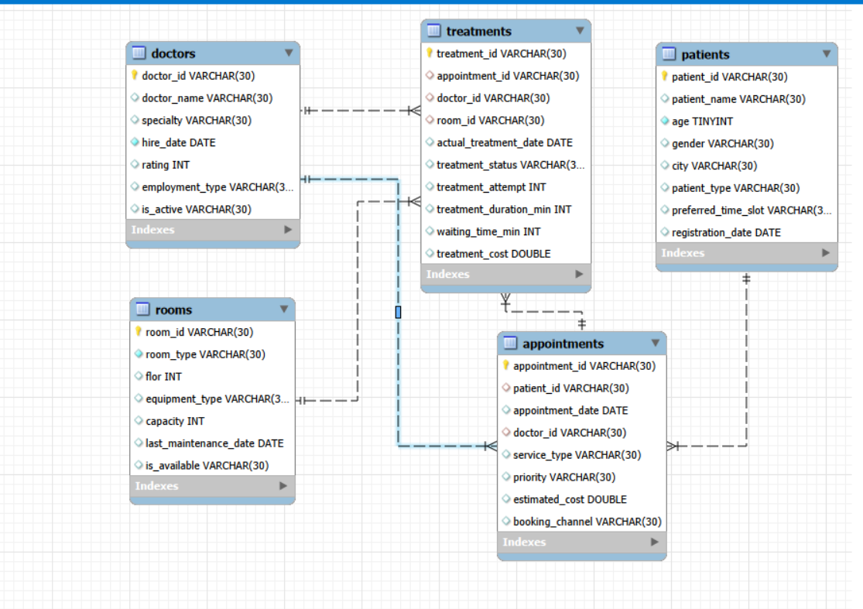
ENTITY-RELATIONSHIP DIAGRAM:

Slide 7
DATABASE SCHEMA OVERVIEW:-
Patients:-
Stores patient details including Patient ID, patient name, age, gender, city, patient type, preferred time slot, and registration date.
Appointments:-
Contains appointment information such as Appointment ID, Patient ID, appointment date, Doctor ID, service type, priority, estimated cost, and booking channel.
Doctors:-
Stores doctor information and details related to doctors providing hospital services.
Treatments:-
Records treatment information including Treatment ID, Appointment ID, treatment status, treatment duration, and waiting time.
Rooms:-
Stores hospital room information including room details, room type, availability, and room allocation information.

Slide 8
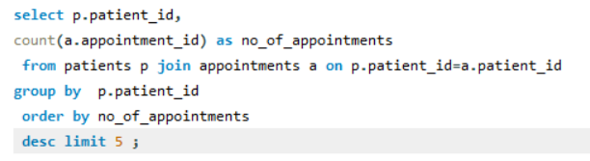
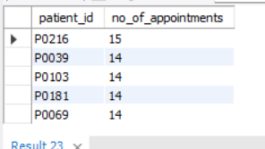
SQL QUERIES: PATIENT & APPOINTMENT INSIGHTS:- 1. Identify the top 5 patients based on the number of appointments. OutPut:

Slide 9
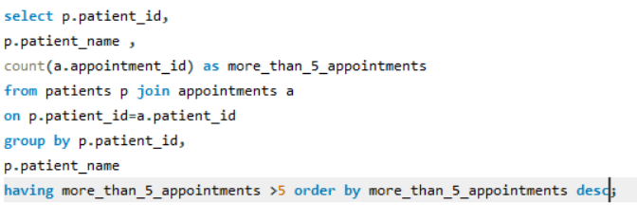
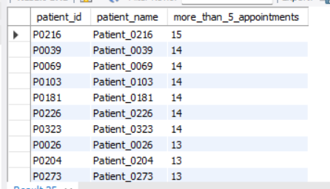
2. Identify patients who have more than 5 appointments. Output:

Slide 10
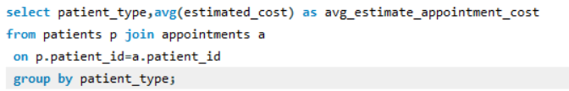
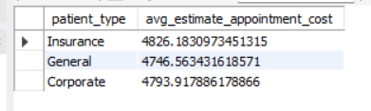
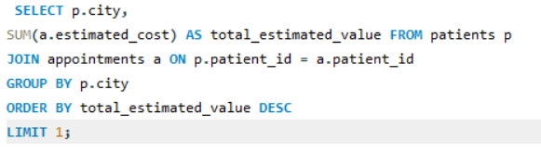

APPOINTMENT ANALYSIS 3. Calculate the average estimated appointment cost for each patient type. Output: 4. Identify the city with the highest total estimated appointment value. Output:

Slide 11
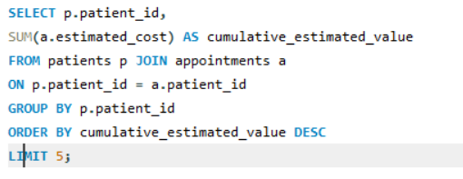
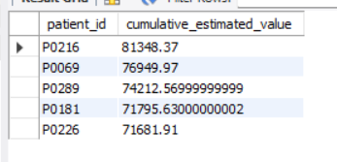
5. Identify the top 5 patients based on their cumulative estimated appointment value. Output:

Slide 12
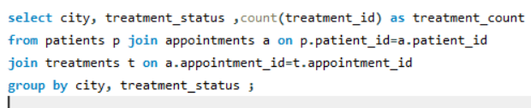
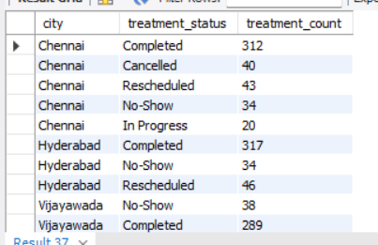
SQL QUERIES: TREATMENT PERFORMANCE INSIGHTS:- 6. Compare treatment outcomes across different cities. Output:

Slide 13
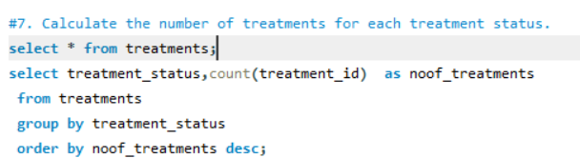
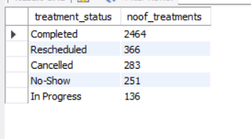
7. Calculate the number of treatments for each treatment status. Treatment status include: Completed Rescheduled Cancelled No-Show In Progress Output:

Slide 14
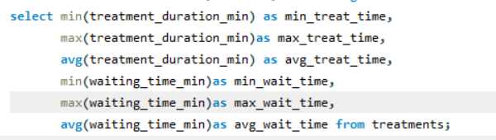
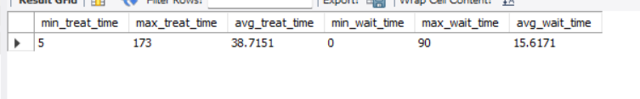
TREATMENT & OPERATIONAL ANALYSIS 8. Calculate the minimum, maximum, and average treatment duration and waiting time. Output:

Slide 15
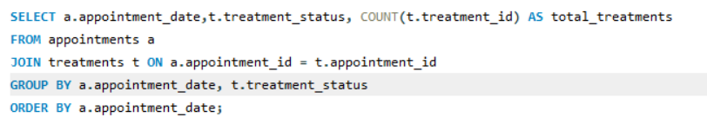
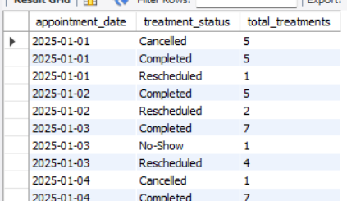
10. Compare treatment performance over time based on appointment date and treatment status Output:

Slide 16
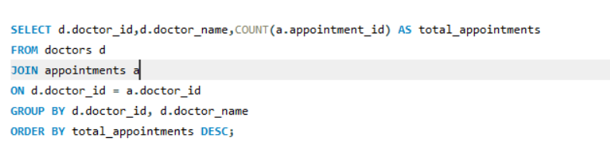
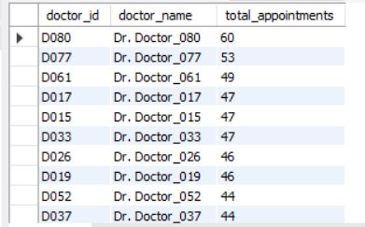
DOCTOR & ROOM ANALYSIS: 11. Analyze appointment activity for each doctor. Output:

Slide 17
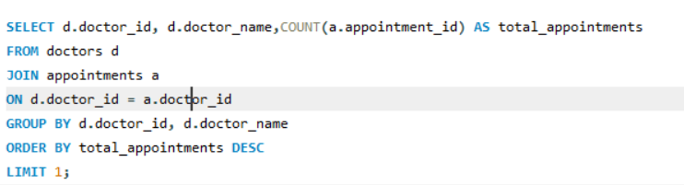

12. Identify doctors handling the highest number of appointments. Output:

Slide 18
KEY INSIGHTS:-
Identified patients with the highest appointment frequency.
Identified patients with more than five appointments.
Compared average estimated appointment costs across patient types.
Identified cities with the highest estimated appointment value.
Identified high-value patients based on cumulative appointment costs.
Analyzed treatment outcomes across different cities.
Compared treatment duration and patient waiting time.
Evaluated doctor appointment activity.
Analyzed room availability and utilization.

Slide 19
HOSPITAL PERFORMANCE INSIGHTS:
Appointment trends help understand patient demand.
City-wise analysis identifies areas with higher hospital activity.
Doctor-wise analysis helps understand workload distribution.
Treatment status analysis highlights successful and unsuccessful outcomes.
Waiting-time analysis helps identify operational bottlenecks.
Room utilization analysis supports better resource allocation.
Patient activity analysis helps understand recurring healthcare demand.
Cost analysis supports better financial and operational planning.

Slide 20
CHALLENGES FACED:-
Designing Relationships
Establishing relationships among patients, appointments, doctors, treatments, and rooms using primary and foreign keys.
Data Consistency
Maintaining referential integrity between related hospital tables.
Complex SQL Queries
Writing multi-table JOIN queries for analytical reports.
Patient & Appointment Tracking
Managing patient appointments and related treatment information efficiently.
Treatment Analysis
Analyzing treatment status, duration, and waiting time using aggregate functions.
Doctor & Room Analysis
Analyzing doctor workload and room utilization for better resource planning.
Query Optimization
Improving execution time for aggregate and multi-table queries.
Testing
Preparing sample datasets and validating query outputs.

Slide 21
CONCLUSION:-
The CarePlus Hospital Management System provides an efficient database solution for managing patients, doctors, appointments, treatments, and rooms.
Key achievements include:
Well-structured relational database design.
Proper implementation of primary and foreign keys.
Efficient management of patient and appointment information.
Analysis of doctor activity and workload.
Evaluation of treatment performance.
Monitoring of treatment duration and waiting time.
Analysis of room availability and utilization.
Successful execution of analytical SQL queries.
Generation of meaningful business insights for hospital operations.
Scalable architecture that can be extended with billing, prescriptions, medical records, and advanced analytics.

Slide 22
THANK YOU

